Slide 1
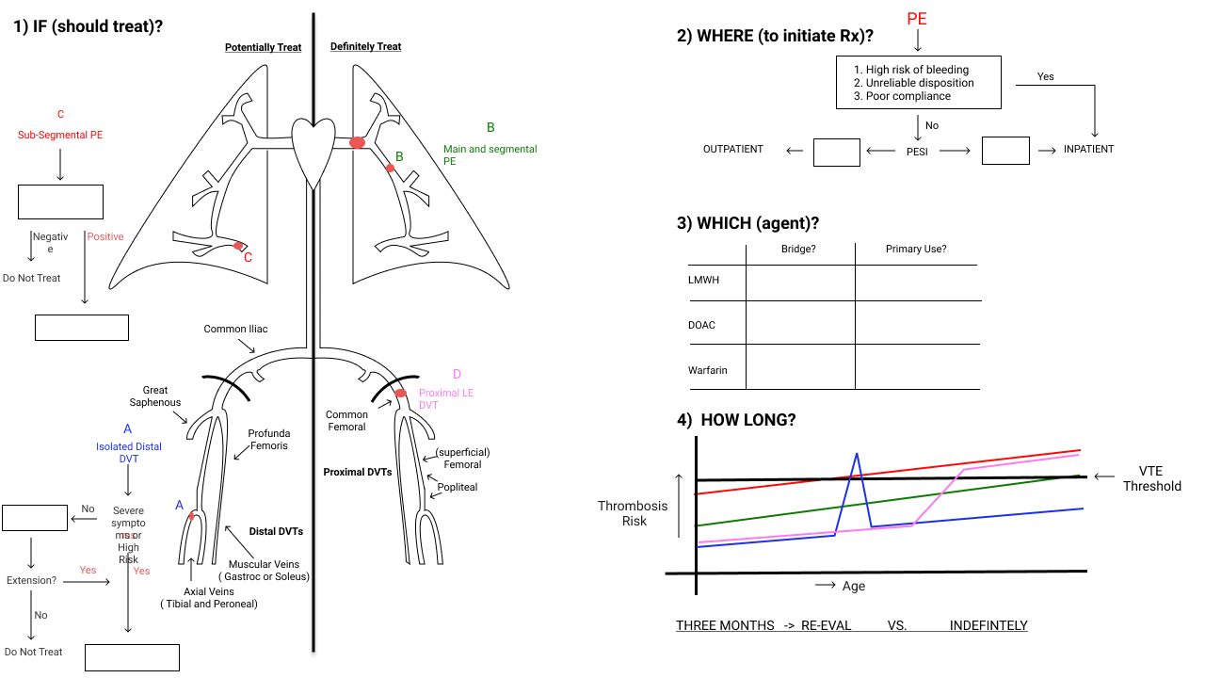

Slide 2
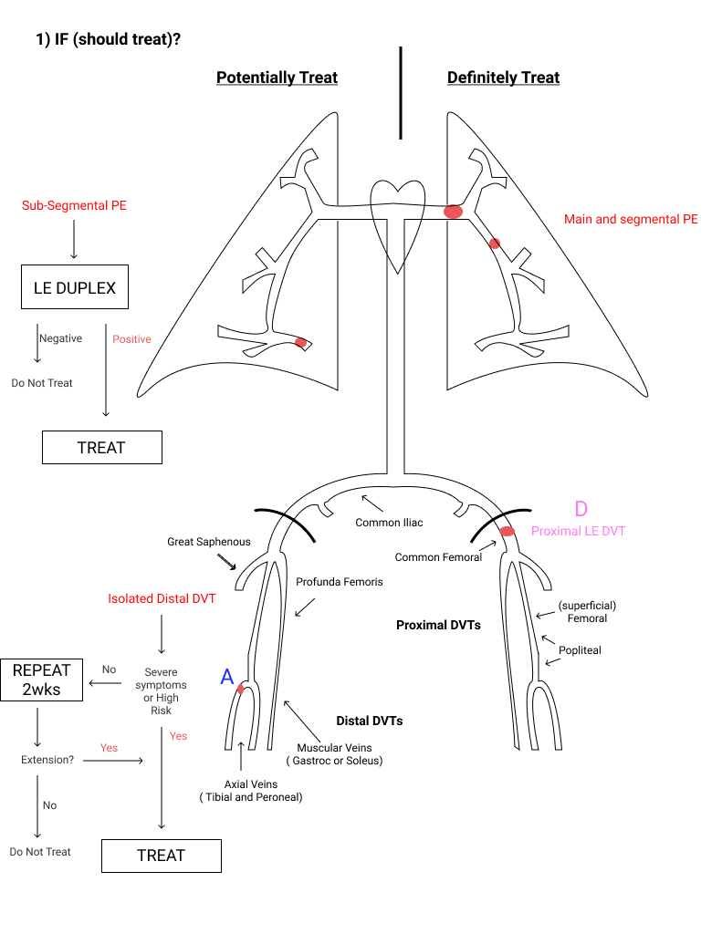

Slide 3
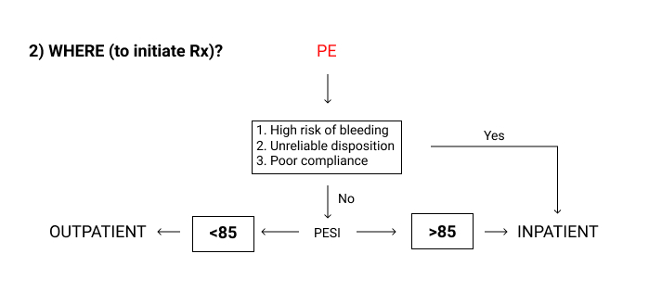

Slide 4
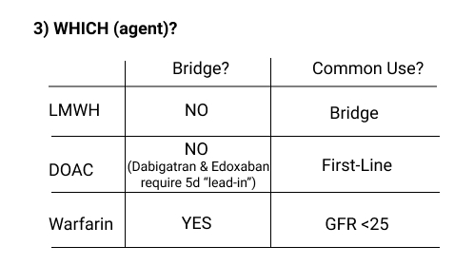

Slide 5
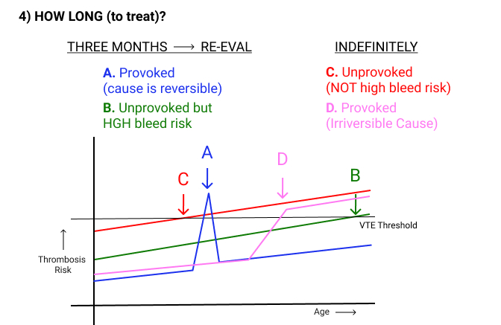

Slide 6
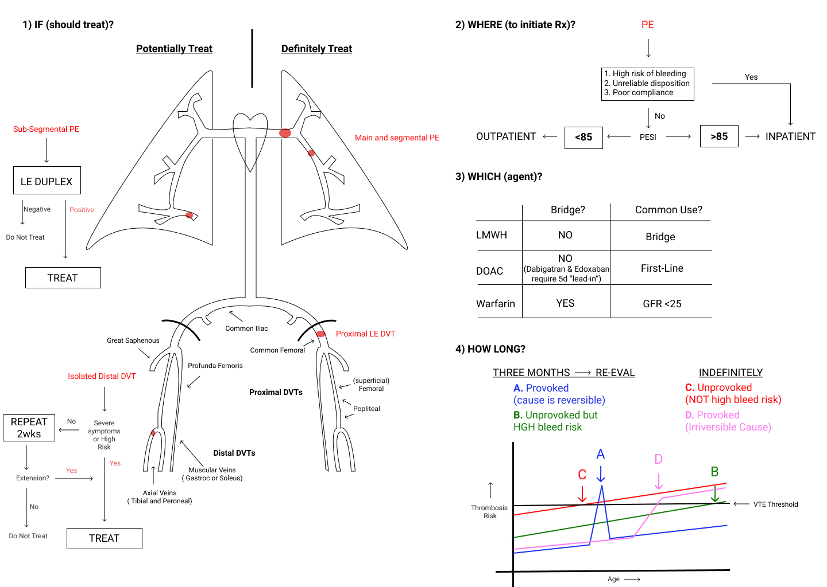

Slide 7
2020–25 Update — Agent Choice, Duration & Special Cases
Cancer-associated VTE — DOACs are now first-line over LMWH:
Apixaban, edoxaban, or rivaroxaban (CARAVAGGIO 2020: apixaban noninferior to dalteparin, no excess major bleeding; ASH 2021, ASCO, ITAC, CHEST 2021).
Apixaban or LMWH preferred for luminal GI malignancies (higher GI bleeding with rivaroxaban/edoxaban). LMWH still favored with poor oral absorption or major drug interactions.
Extended (>3–6 mo) therapy — reduced-dose DOAC lowers bleeding:
Apixaban 2.5 mg BID (AMPLIFY-EXT) or rivaroxaban 10 mg daily (EINSTEIN-CHOICE) for the extended phase after the initial treatment period.
Special cases:
Antiphospholipid syndrome (esp. triple-positive): use warfarin, NOT a DOAC (TRAPS — excess arterial events with rivaroxaban).
Isolated subsegmental PE without proximal DVT & low recurrence risk: surveillance is an option over anticoagulation (CHEST 2021) — matches the board's SSPE → duplex pathway.
Standing framework (IF / WHERE / WHICH / HOW LONG) unchanged: PESI <85 → outpatient; DOAC first-line; unprovoked without high bleed risk → indefinite.

Slide 8
Take-Home Points
IF: not every clot is treated — isolated distal DVT (low risk, asymptomatic) can be surveilled with repeat duplex in 1–2 weeks; isolated subsegmental PE without proximal DVT may be surveilled.
WHERE: an uncomplicated PE with PESI <85 (or sPESI 0) can be managed as an outpatient; admit for high bleeding risk, unreliable disposition, or poor compliance.
WHICH: DOACs are first-line for stable VTE, including most cancer-associated VTE; LMWH/apixaban preferred for luminal GI cancers; warfarin for antiphospholipid syndrome and CrCl <25–30.
HOW LONG: provoked by a reversible cause → ~3 months; unprovoked or an irreversible/persistent cause without high bleed risk → indefinite anticoagulation (consider reduced-dose DOAC for the extended phase).

Slide 9
Attribution & Optimization Note
Adapted from TeachIM.org — “Management of Venous Thromboembolism (VTE)” (Meagan Wong MD, Brandon Fainstad MD; expert review David Garcia MD). Published 2020.
Source: teachim.org/teaching_material/venous-thromboembolism-vte/ · License: CC BY-NC 4.0 (attribution, non-commercial only).
Deck note: TeachIM publishes this as a non-interactive series of whiteboard board-set-up images (no editable text runs) intended to be reproduced on a whiteboard. No surgical text edits were possible or needed — the IF/WHERE/WHICH/HOW-LONG framework matches current guidance.
Added context (source-cited): cancer-VTE DOAC-first (CARAVAGGIO 2020; ASH 2021/CHEST 2021), reduced-dose extended DOAC (AMPLIFY-EXT, EINSTEIN-CHOICE), APS→warfarin (TRAPS), subsegmental-PE surveillance.
Companion files: VTE-Learners-Handout.pdf (4 cases), VTE-Teachers-Guide.pdf. Educational use only; not medical advice — have content clinician-reviewed before teaching.

